Slide 1
Betwixt St. Francis & St. Luke
The Healing power of creation

Slide 2
Be praised, my Lord, through all your creatures, especially through my lord Brother Sun, who brings the day; and you give light through him. And he is beautiful and radiant in all his splendour!
Of you, Most High, he bears the likeness.

Slide 3
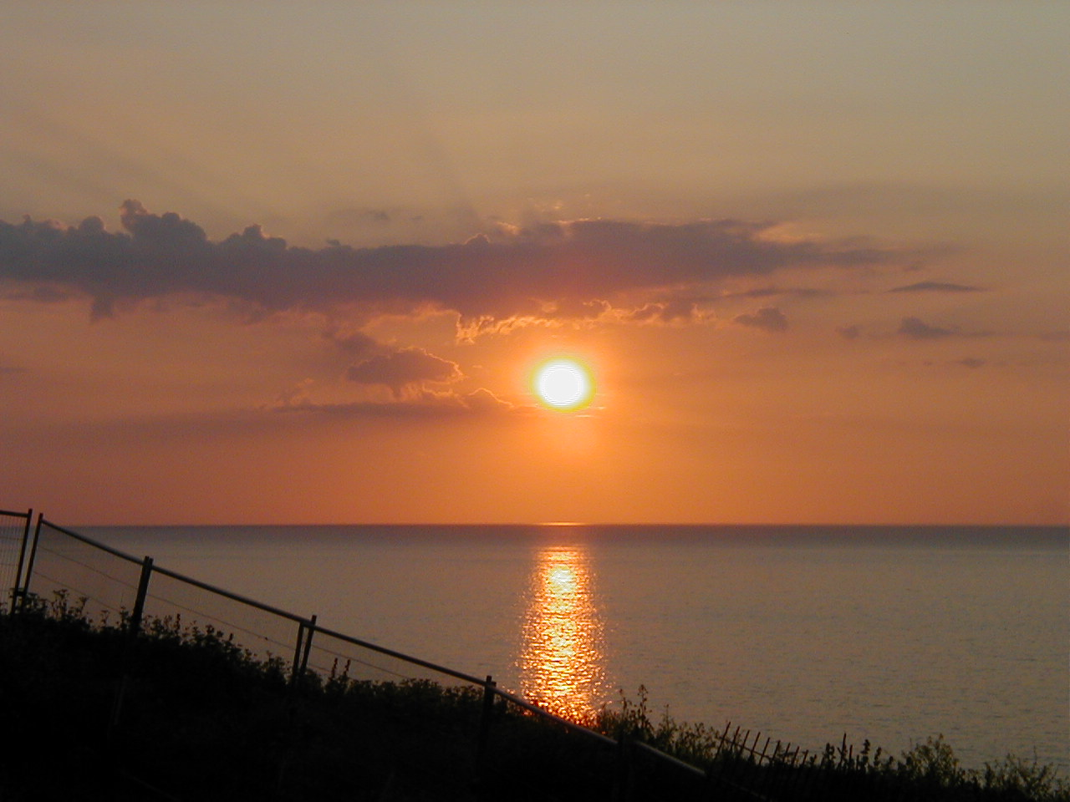

Slide 4
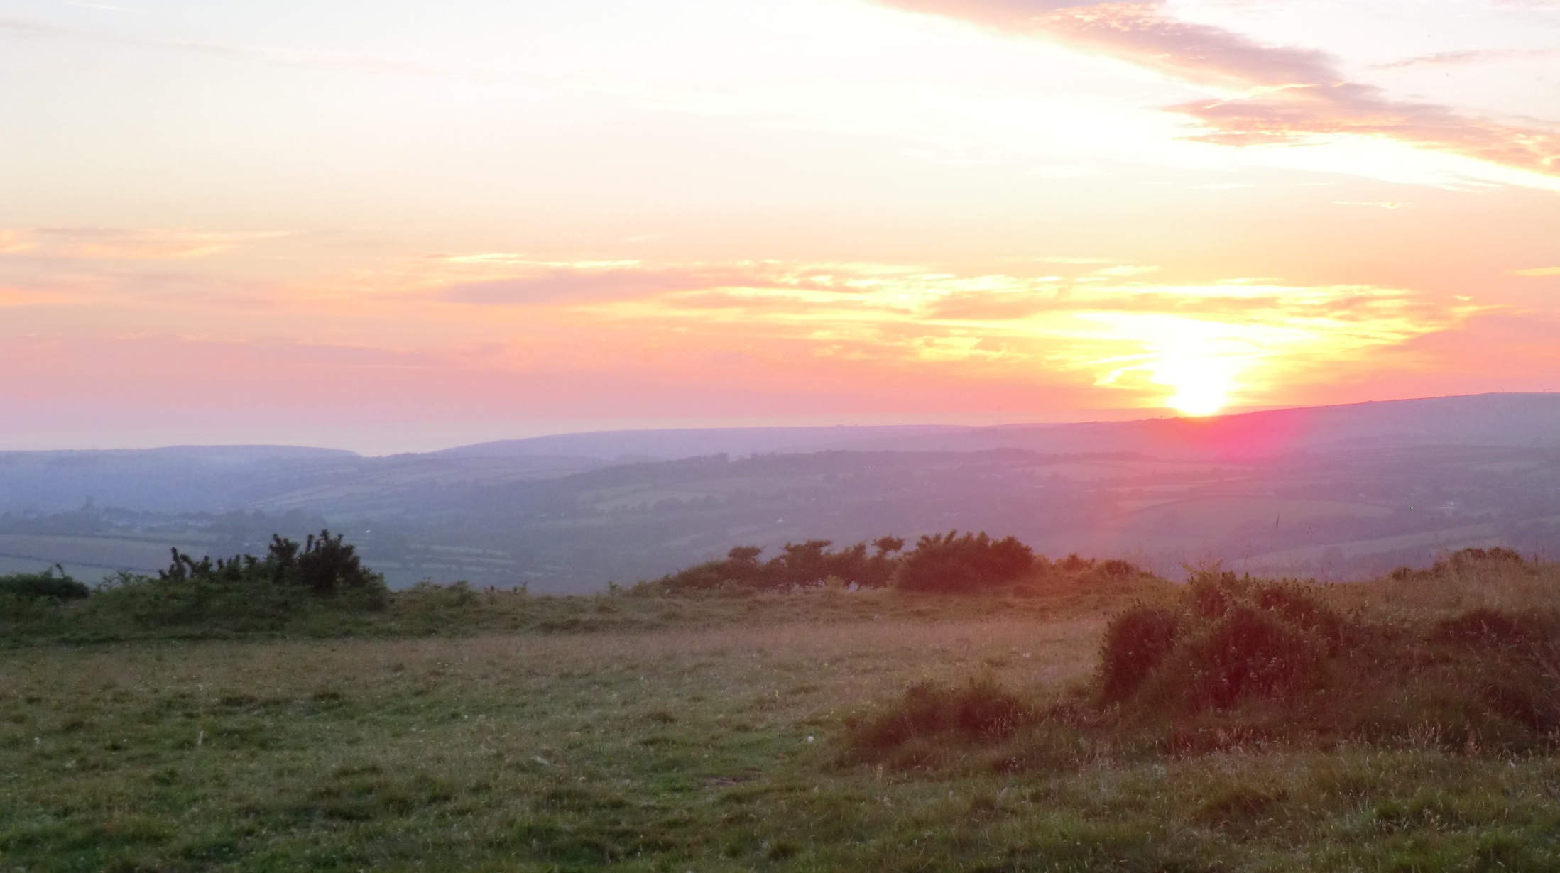

Slide 5
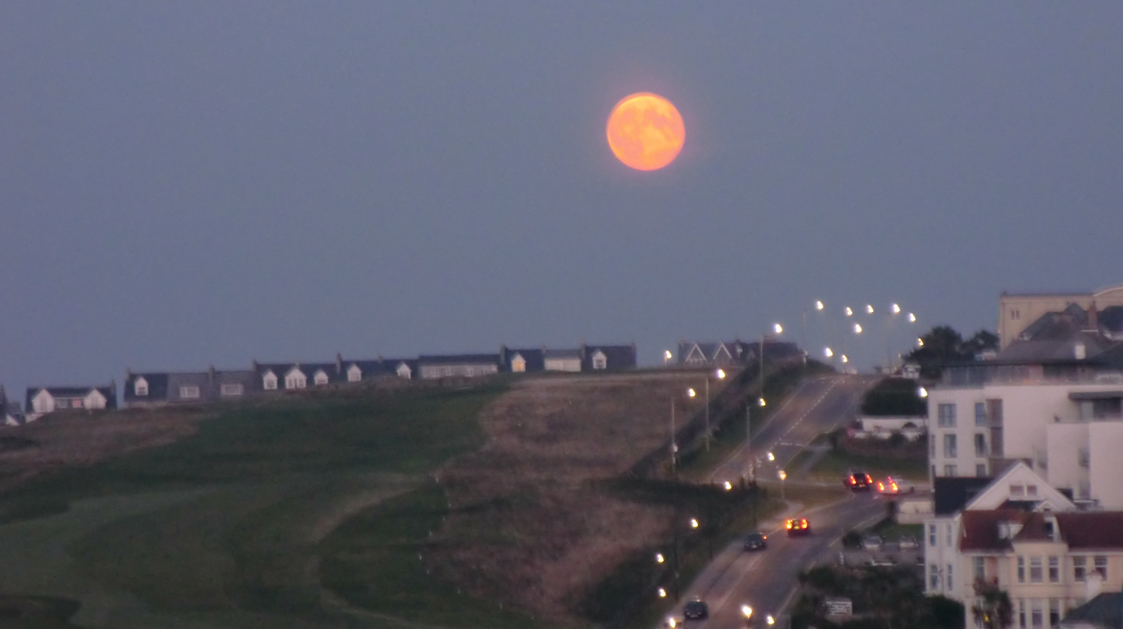
Be praised, my Lord, through Sister Moon and the stars; in the heavens you have made them, precious and beautiful.

Slide 6
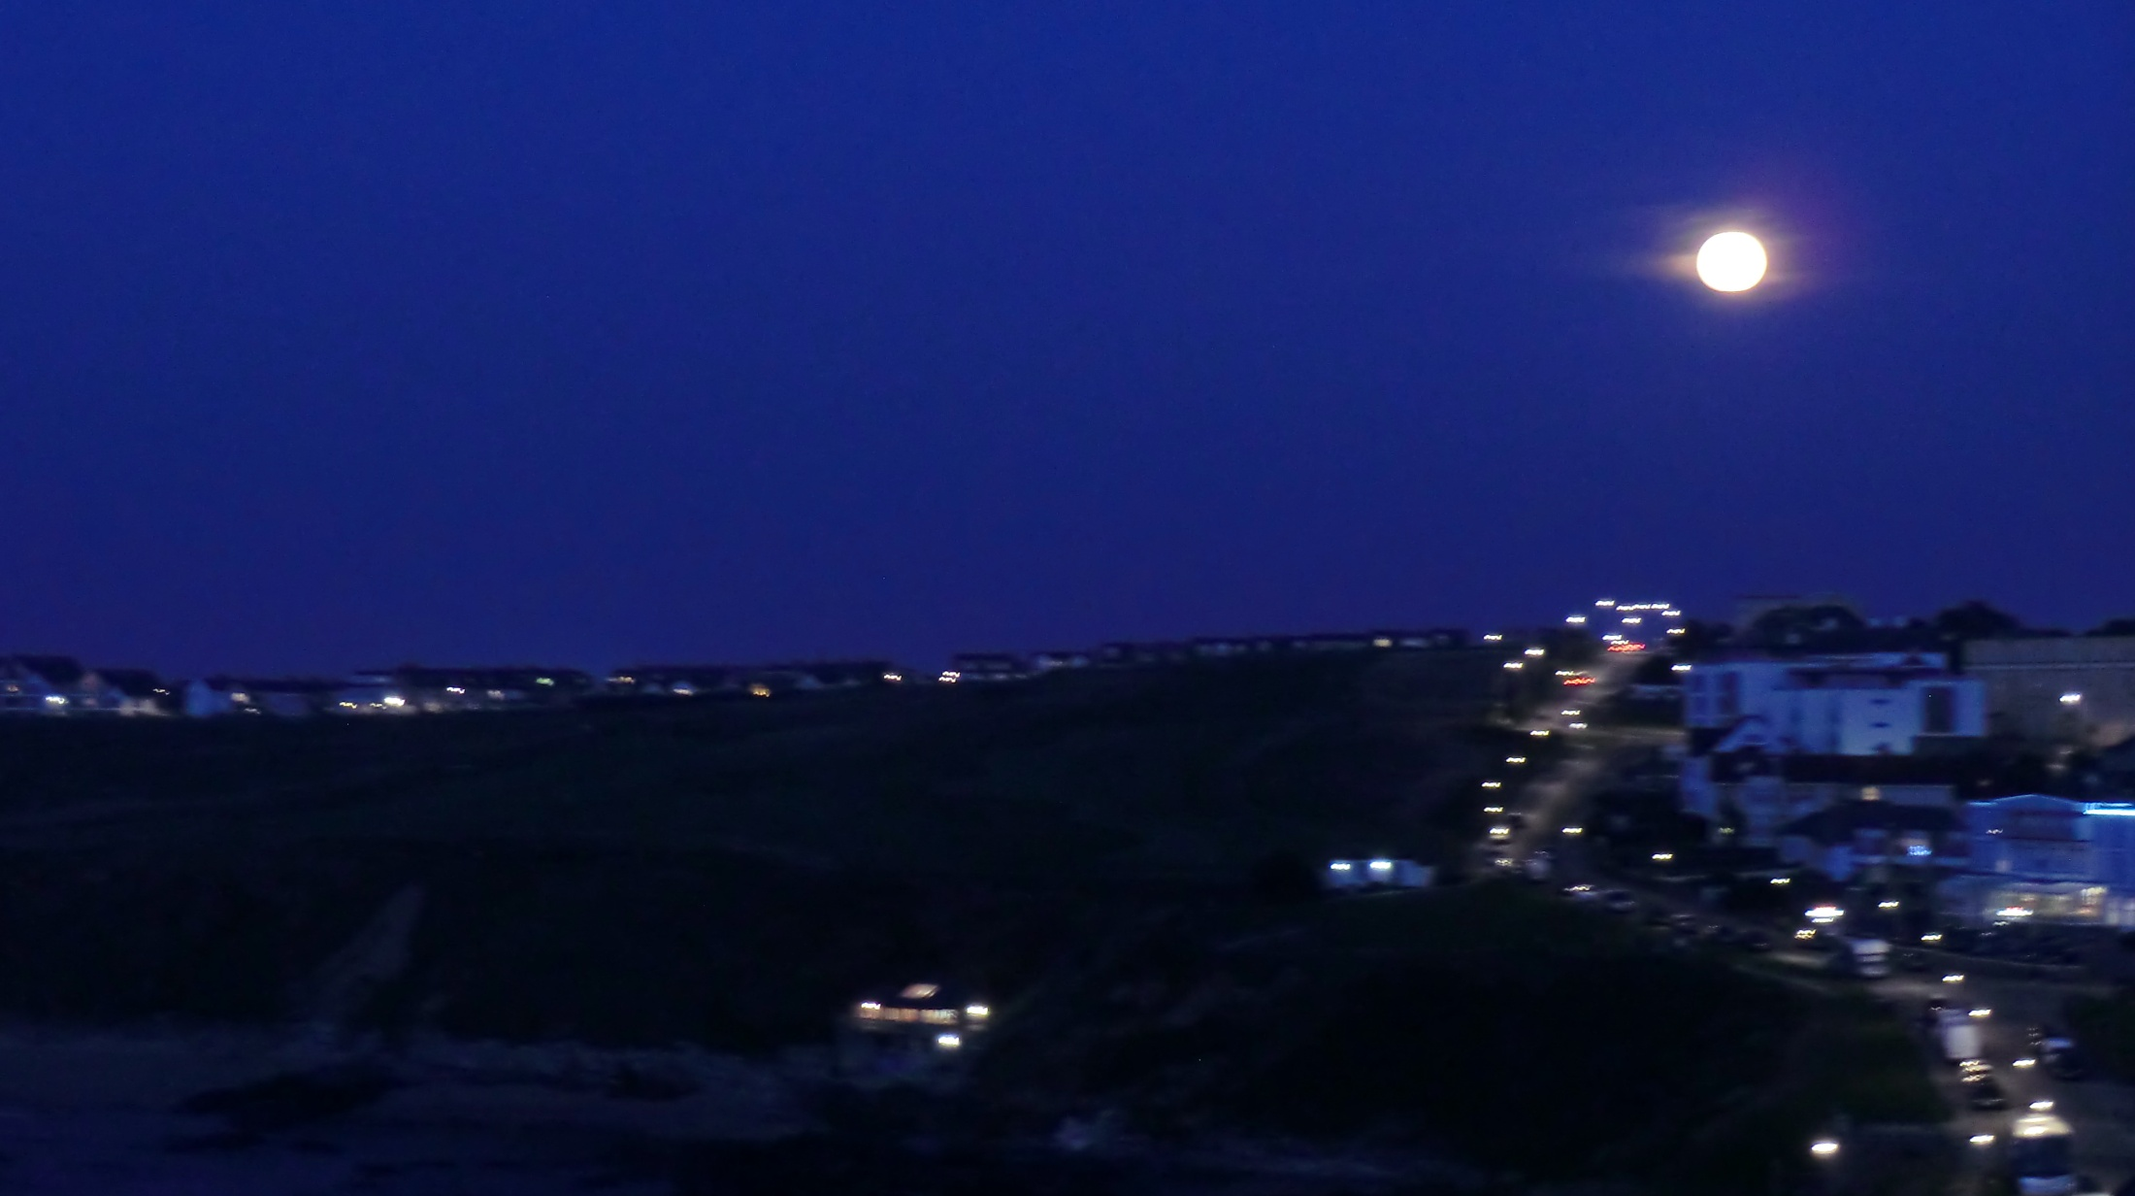

Slide 7
Be praised, my Lord, through Brothers Wind and Air, and clouds and storms, and all the weather,
through which you give your creatures sustenance.

Slide 9
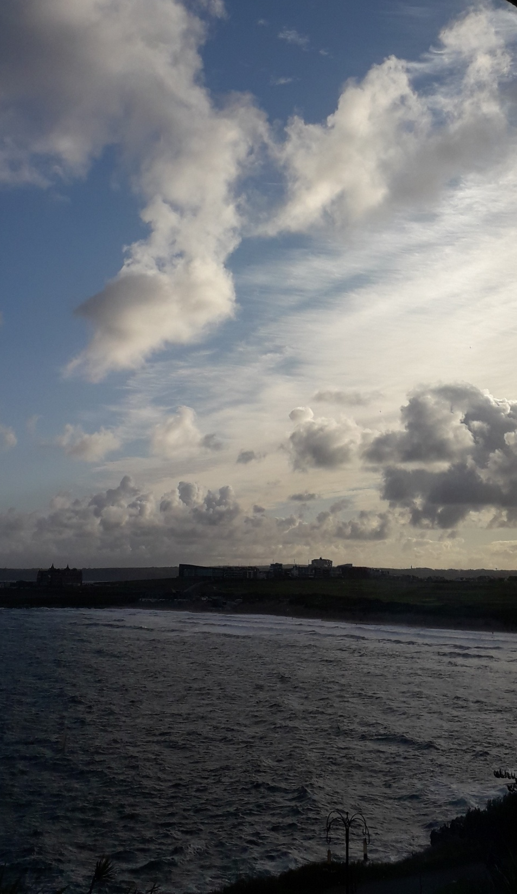

Slide 10
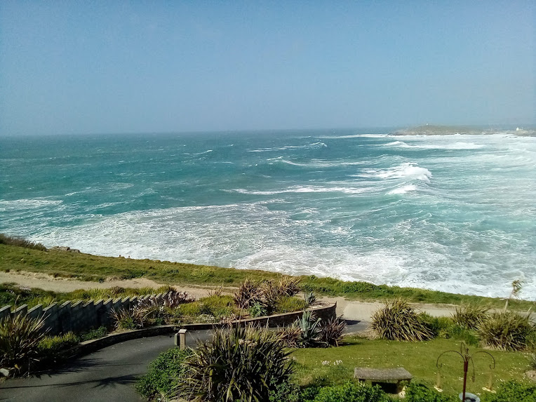
Be praised, My Lord, through Sister Water; she is very useful, and humble, and precious, and pure.

Slide 12
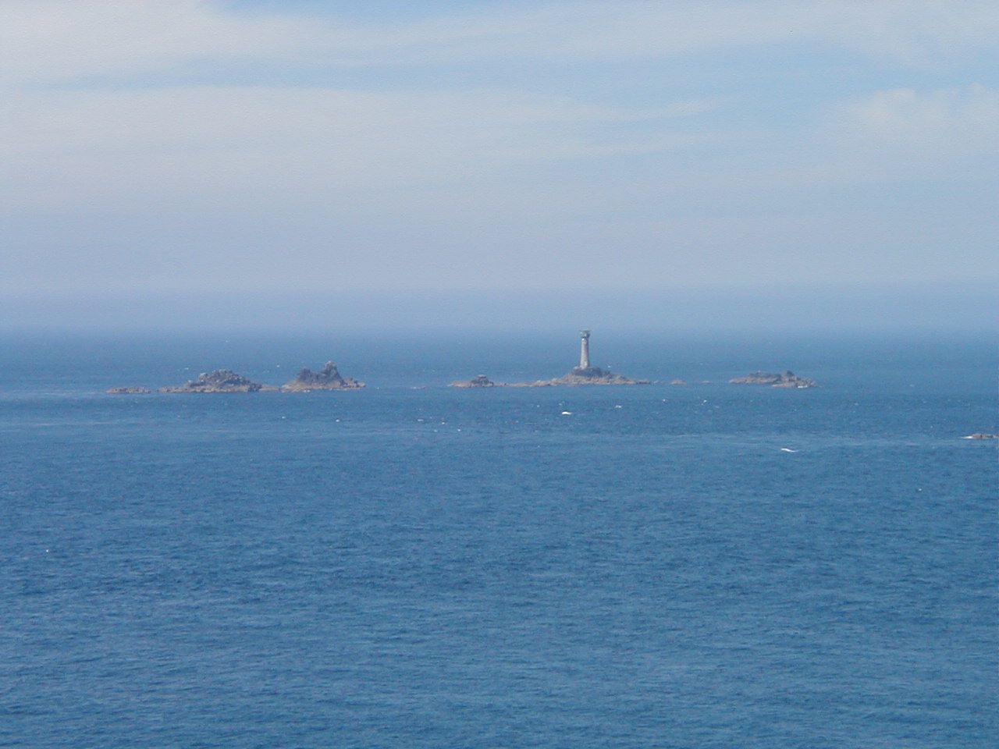

Slide 13
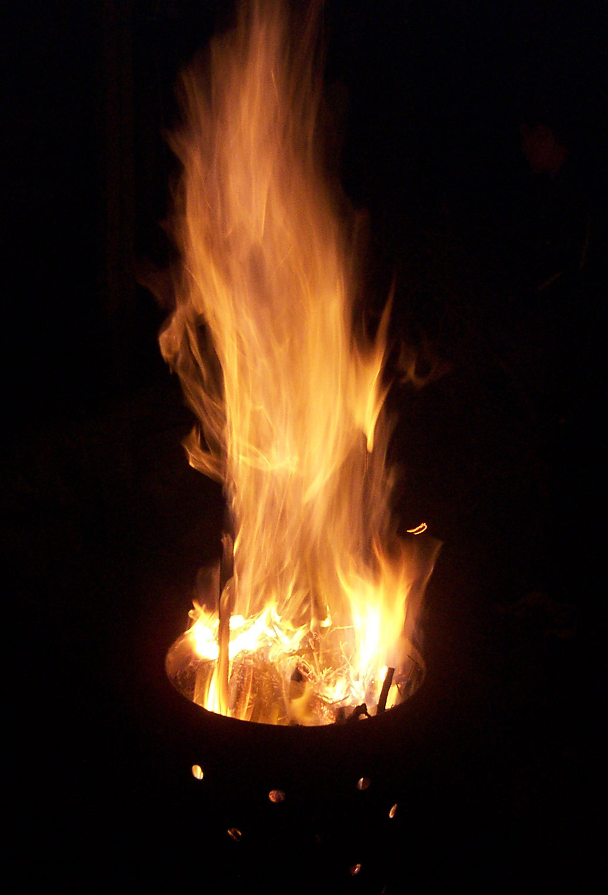
Be praised, my Lord, through Brother Fire, through whom you brighten the night.
He is beautiful and cheerful, and powerful and strong.

Slide 14
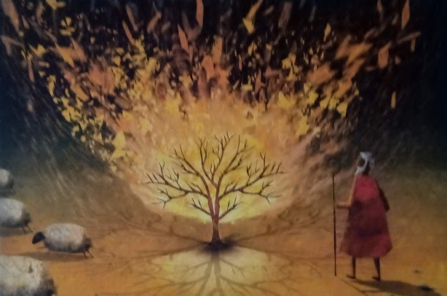

Slide 15
Be praised, my Lord, through our sister Mother Earth, who feeds us and rules us, and produces various fruits with coloured flowers and herbs.

Slide 16
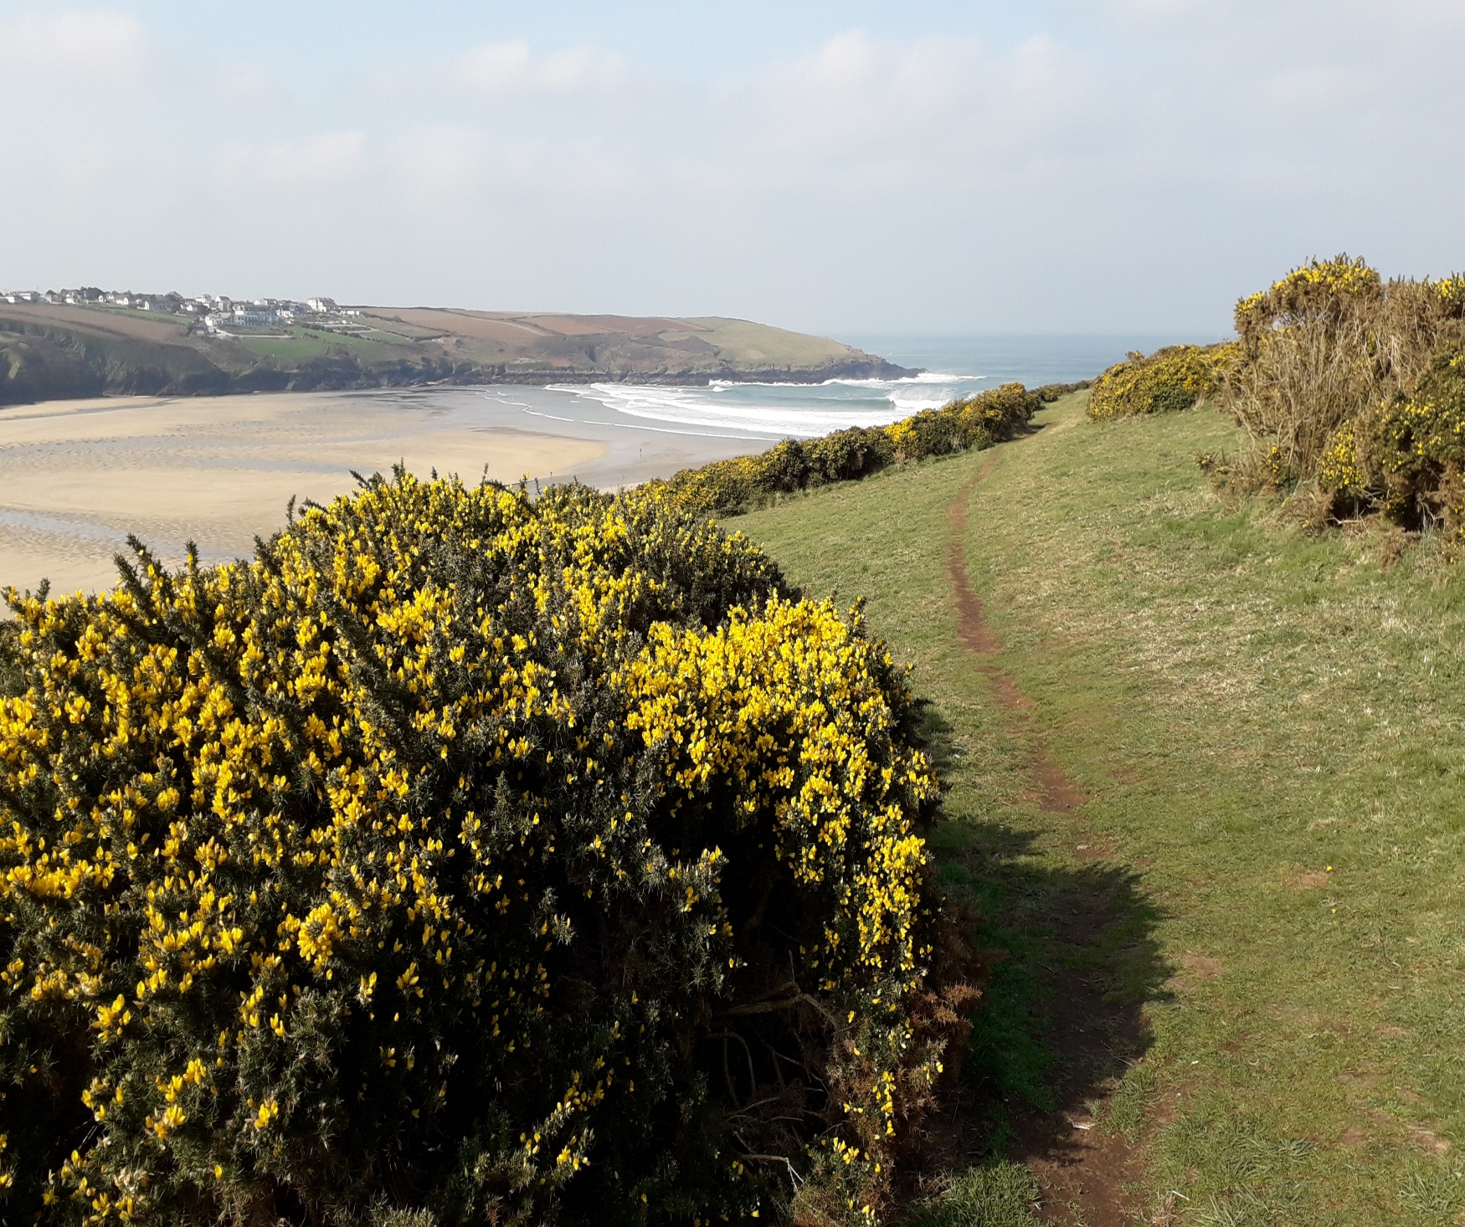

Slide 18
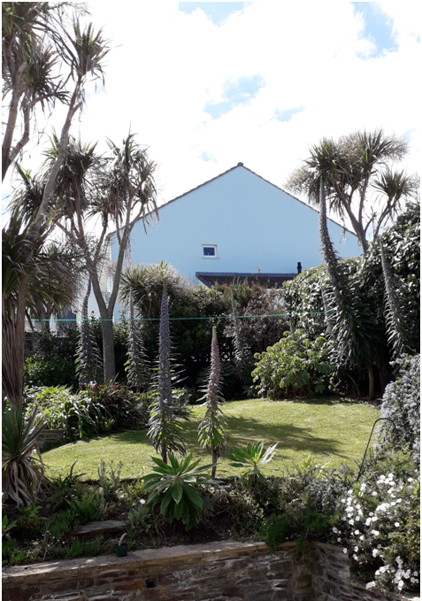

Slide 20
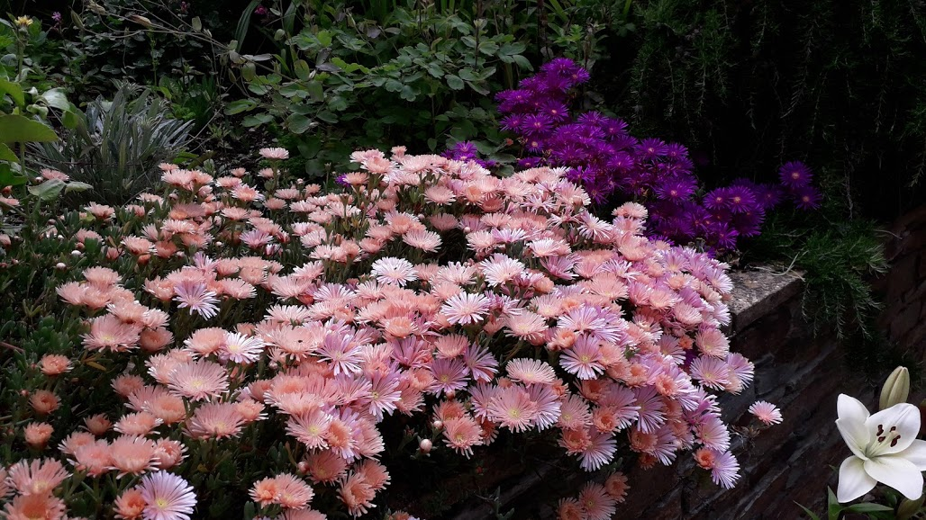

Slide 21
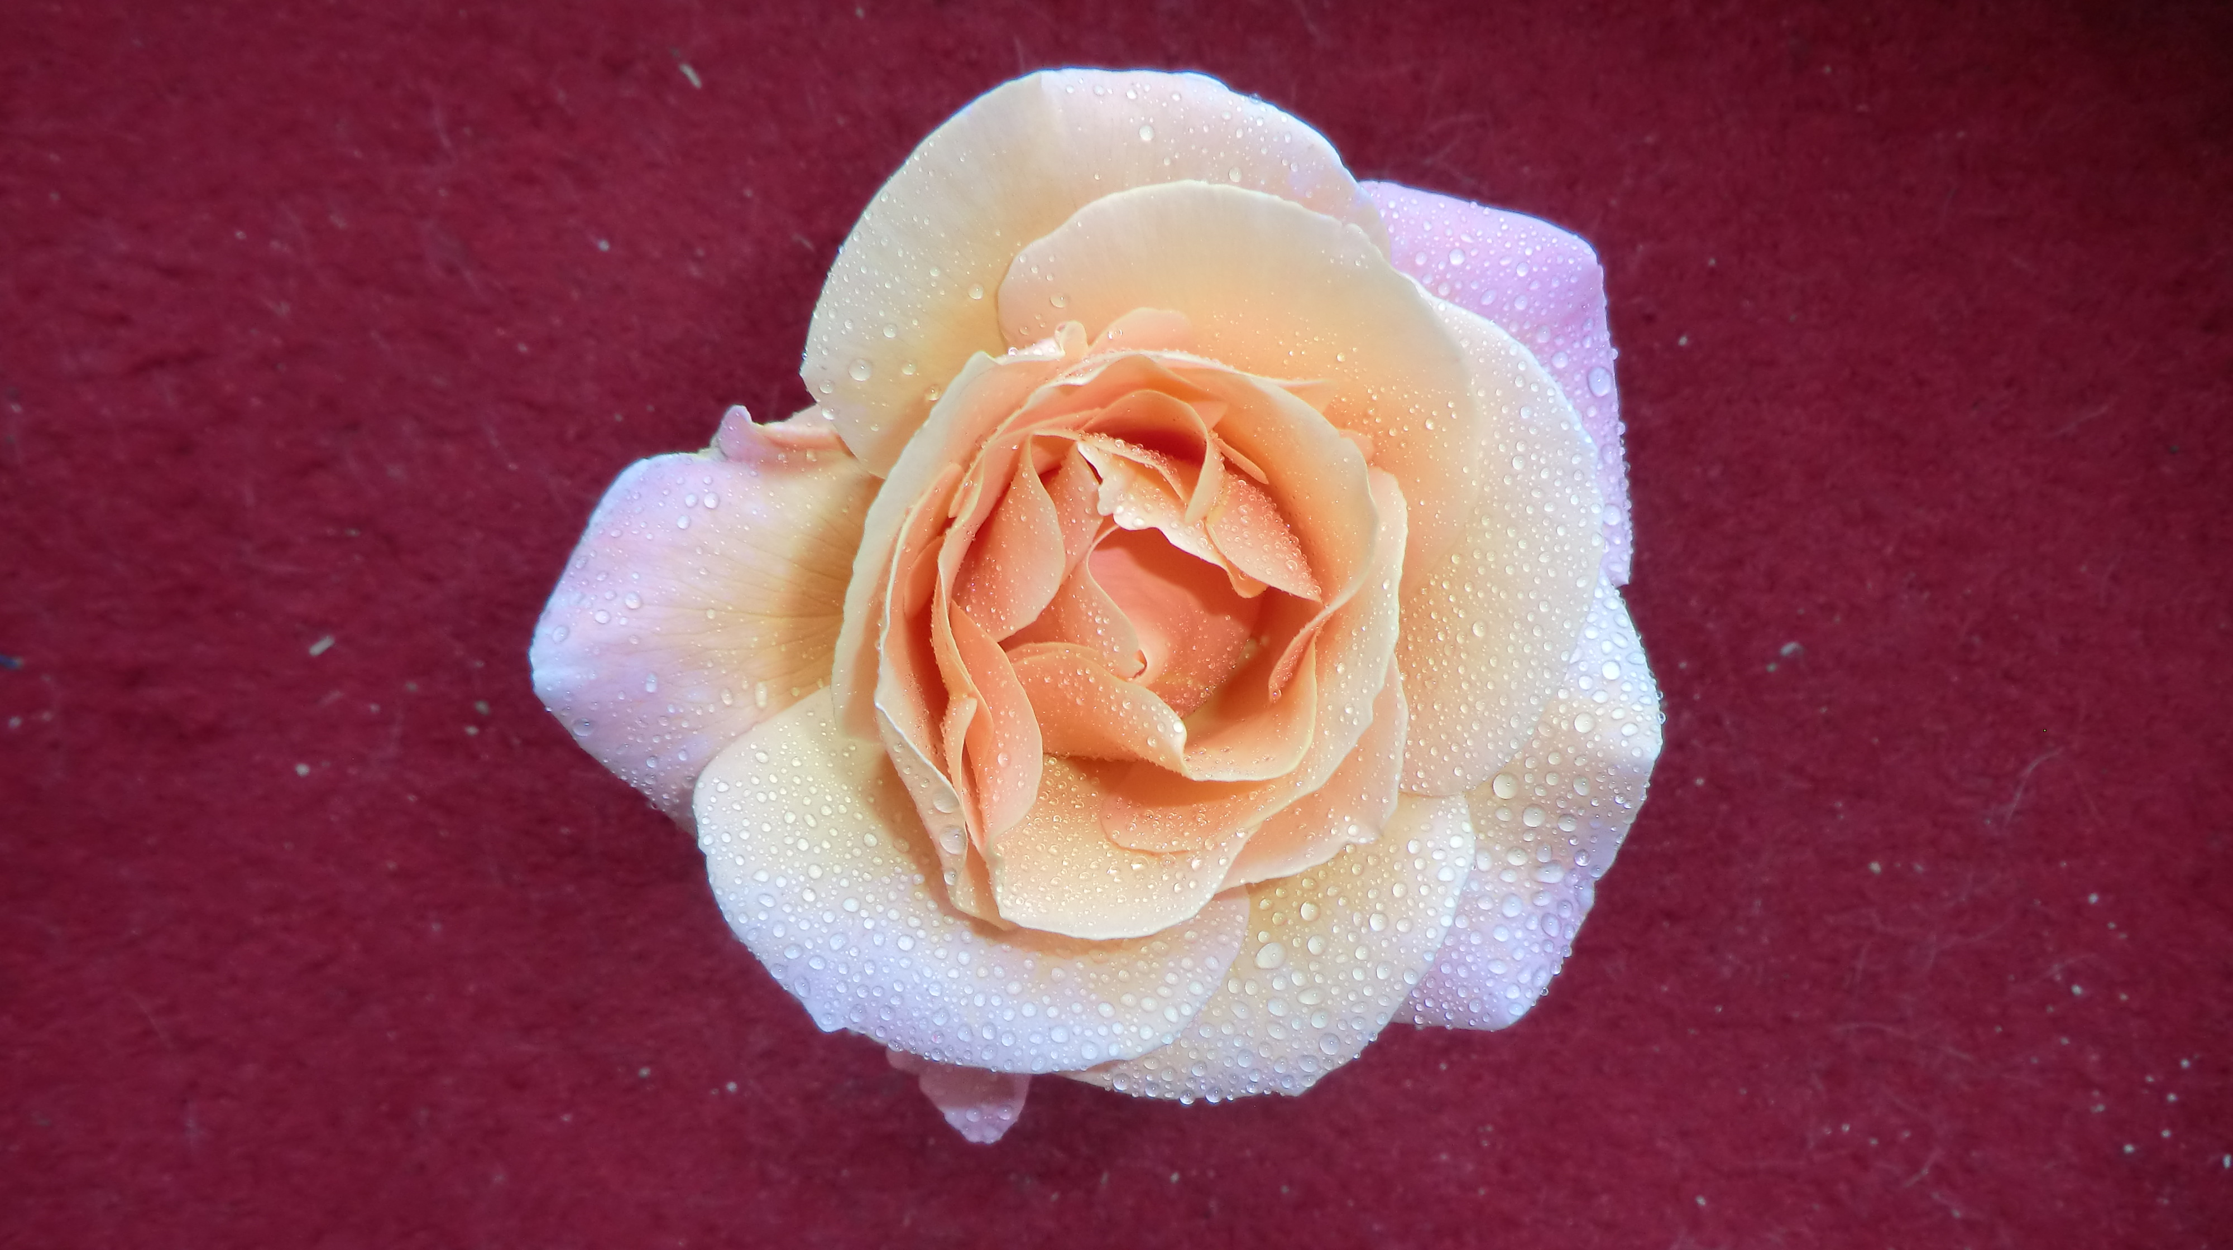

Slide 22
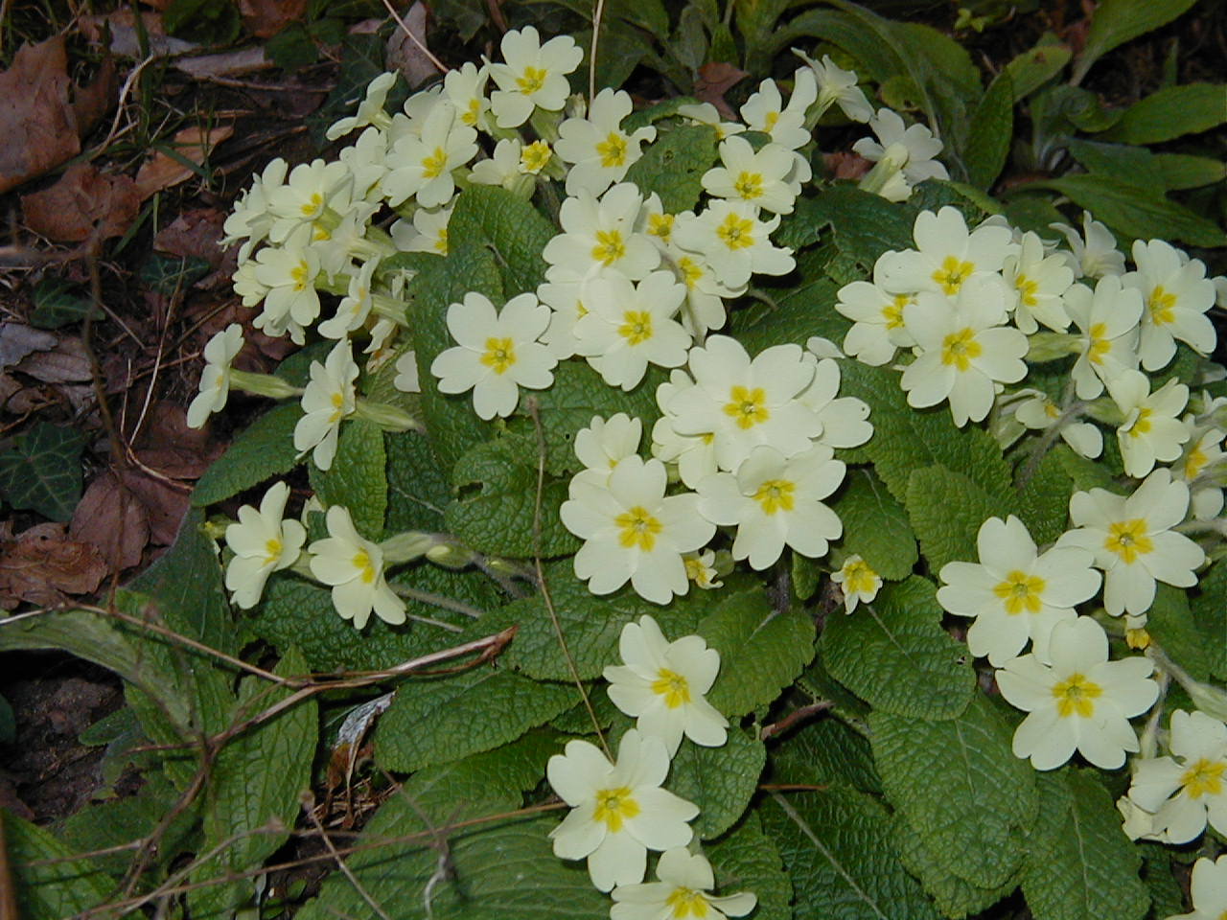

Slide 23
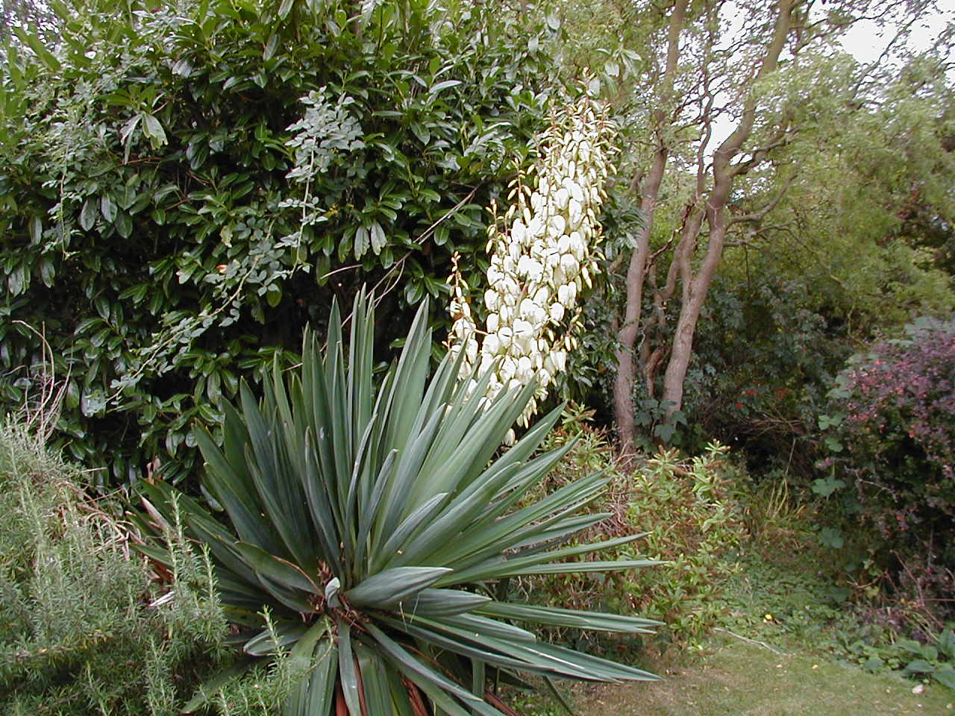

Slide 24
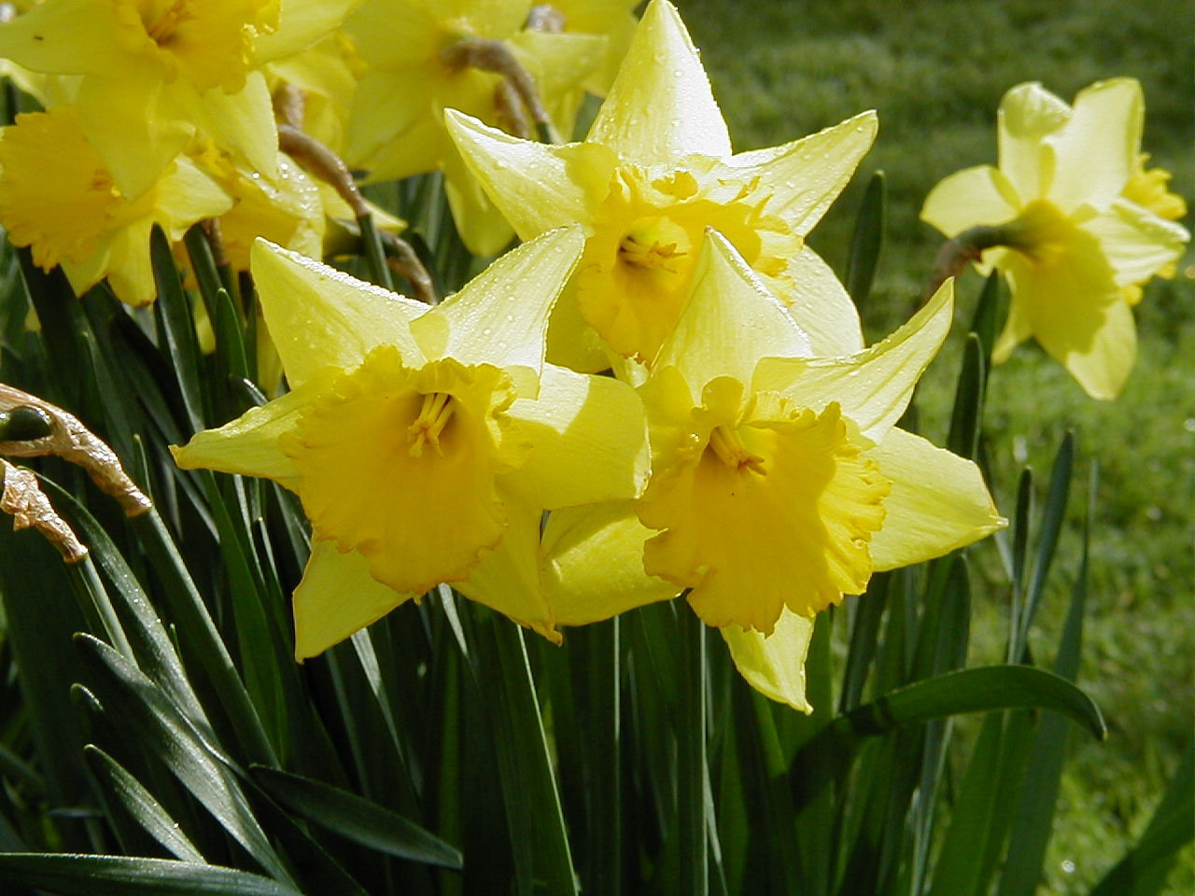

Slide 25
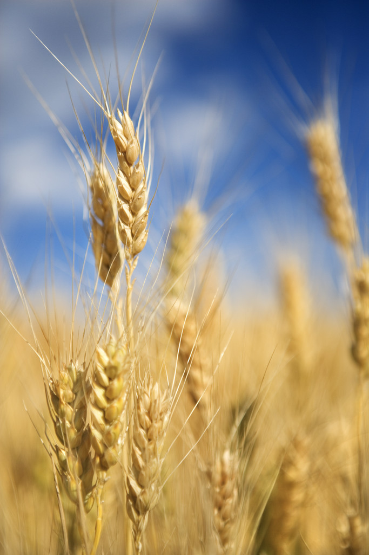

Slide 26
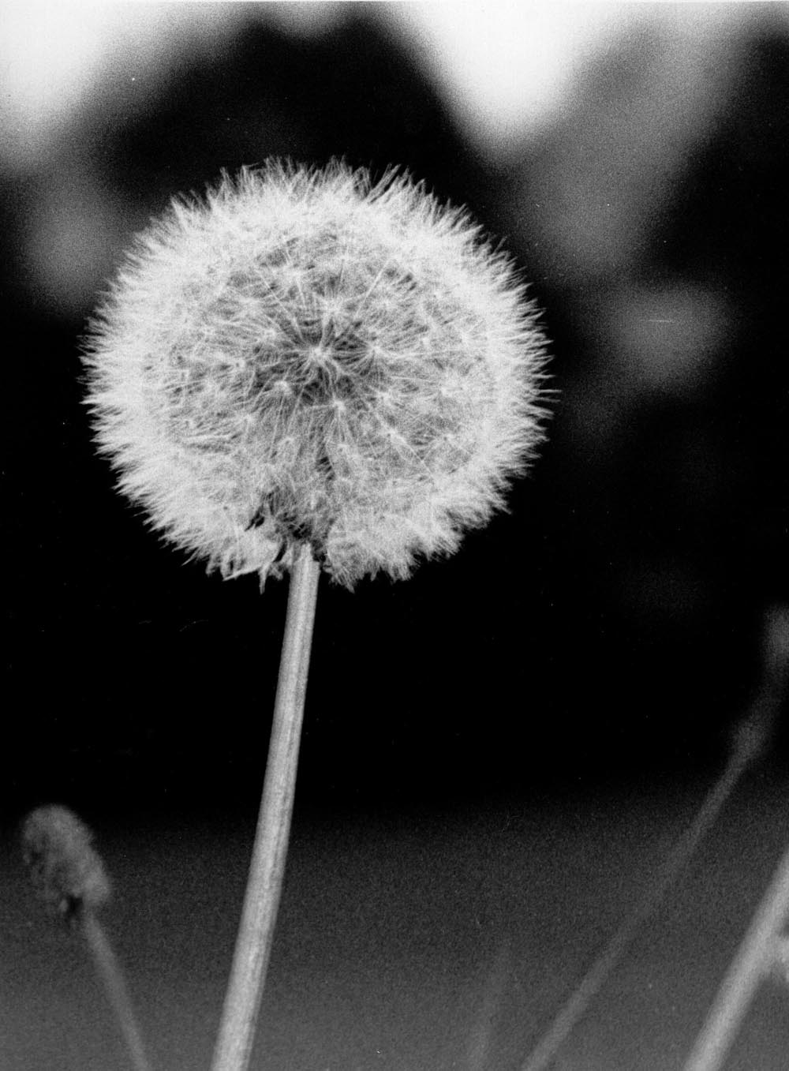

Slide 27
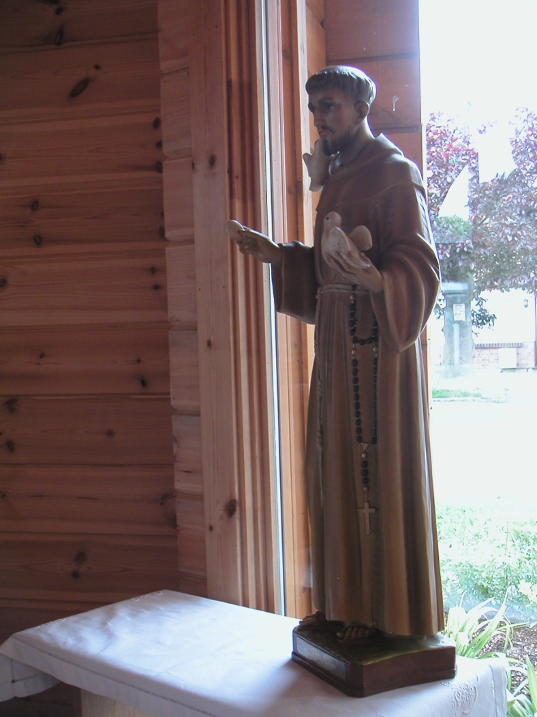
Praised be You, my Lord, through those who give pardon for Your love, and bear infirmity and tribulation.
Blessed are those who endure in peace for by You, Most High, they shall be crowned.
Statue. St. Francis, West Horndon

Slide 28
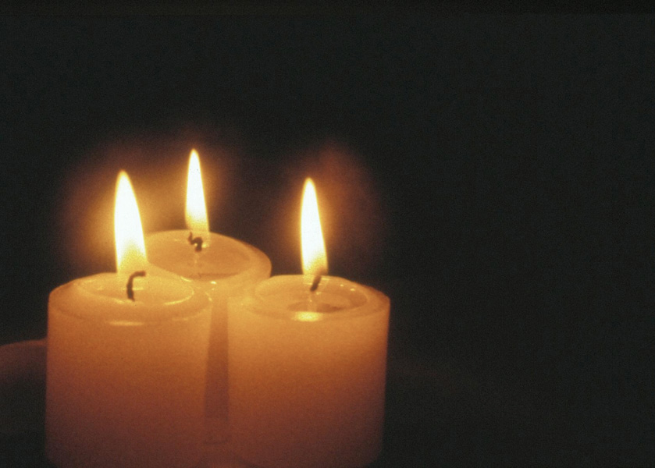
Praised be You, my Lord, through our Sister Bodily Death, from whom no living man can escape.
Woe to those who die in mortal sin. Blessed are those who will find Your most holy will, for the second death shall do them no harm
.
Praise and bless my Lord, and give Him thanks and serve Him with great humility.^{[3]}

